Slide 1
PROJECT TITLE: Multiclass Fish Image Classification DOMAIN: Image Classification SUBMITTED BY: Varshini S BATCH NUMBER: MTD47 [DS-S-WE-T-B30] ORGANIZATION NAME: GUVI COURSE NAME: Data Science

Slide 2
TABLE OF CONTENTS
SECTION | PAGE NUMBER
Problem Statement & Objective | 3
Introduction | 4
Approach and Workflow | 5
Dataset Description | 6
Business Use Cases | 7
Model Comparison & Best Performing Model | 8
Deployment | 10
Result & Output | 11
Conclusion | 12

Slide 3
PROBLEM STATEMENT
This project focuses on classifying fish images into multiple categories using deep learning models. The task involves training a CNN from scratch and leveraging transfer learning with pre-trained models to enhance performance. The project also includes saving models for later use and deploying a Streamlit application to predict fish categories from user-uploaded images.
OBJECTIVE
Build a deep learning model to classify fish images into species.
Deploy it using a user-friendly web interface (Streamlit).

Slide 4
INTRODUCTION
The identification and classification of fish species is a critical task in marine biology, fisheries management, and environmental monitoring. Traditional methods often rely on manual identification, which can be time-consuming, inconsistent, and prone to human error.
With the rapid advancement of Artificial Intelligence (AI) and Deep Learning technologies, automated image classification has become a powerful solution. This project focuses on developing a deep learning model to accurately classify fish species from images using a pre-trained EfficientNetB0 architecture.
The aim is to create a user-friendly web-based application that allows users to upload an image of a fish and receive instant predictions of its species along with confidence scores. This approach enhances accuracy, scalability, and accessibility in fish species identification.

Slide 5
APPROACH AND WORKFLOW
📁 Dataset (Fish Images)
↓
📊 Data Preprocessing (Resize, Normalize, Split)
↓
🤖 Model Training (EfficientNetB0 / CNN)
↓
📈 Model Evaluation (Accuracy, Loss, Confusion Matrix)
↓
💾 Save Trained Model (.h5 format)
↓
🌐 Streamlit App (Upload Image → Predict Class → Show Confidence Score)

Slide 6
DATASET DESCRIPTION
ABOUT: Fisheries Dataset
CATEGORIES: 11 fish classes
CLASSES: animal fish, animal fish bass, black sea sprat, gilt head bream, hourse mackerel, red mullet, red sea bream, sea bass, shrimp, striped red mullet, trout.

Slide 7
BUSINESS USE CASES
Enhanced Accuracy: Determine the best model architecture for fish image classification.
Deployment Ready: Create a user-friendly web application for real-time predictions.
Model Comparison: Evaluate and compare metrics across models to select the most suitable approach for the task.

Slide 8
Model Comparison & Best Performing Model
Models Tested:
✅ Custom CNN – Basic architecture with Conv2D, MaxPooling, Dense layers
✅ VGG16 – Transfer learning with deep feature extraction
✅ ResNet50 – Handled vanishing gradient well with skip connections
✅ MobileNetV2 – Lightweight and optimized for mobile inference
✅ EfficientNetB0 – Compound scaling of depth, width, and resolution.
Best Performing Model: EfficientNetB0
Highest Validation Accuracy and Top-3 Confidence Scores
Balanced Efficiency and Performance
Required fewer epochs to converge
Generalized well on unseen fish species images

Slide 9
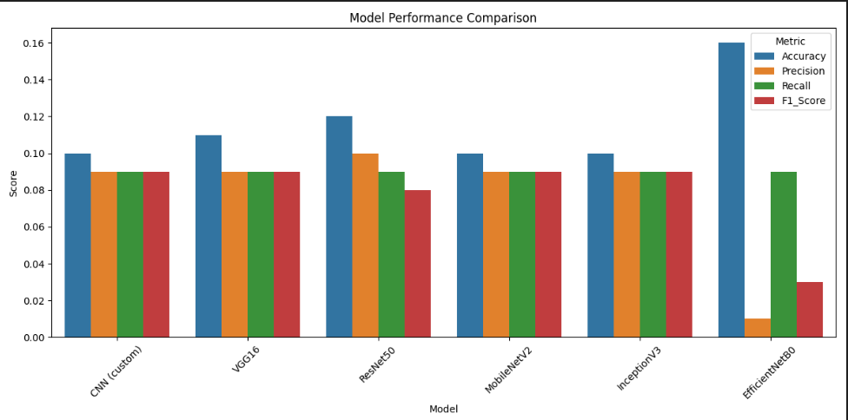
MODEL COMPARISON
Model,Accuracy,Precision,Recall,F1_Score
CNN (custom), 0.1, 0.09, 0.09, 0.09
VGG16, 0.11, 0.09, 0.09, 0.09
ResNet50, 0.12, 0.1, 0.09, 0.08
MobileNetV2, 0.1, 0.09, 0.09, 0.09
InceptionV3, 0.1, 0.09, 0.09, 0.09
EfficientNetB0, 0.16, 0.01, 0.09, 0.03

Slide 10
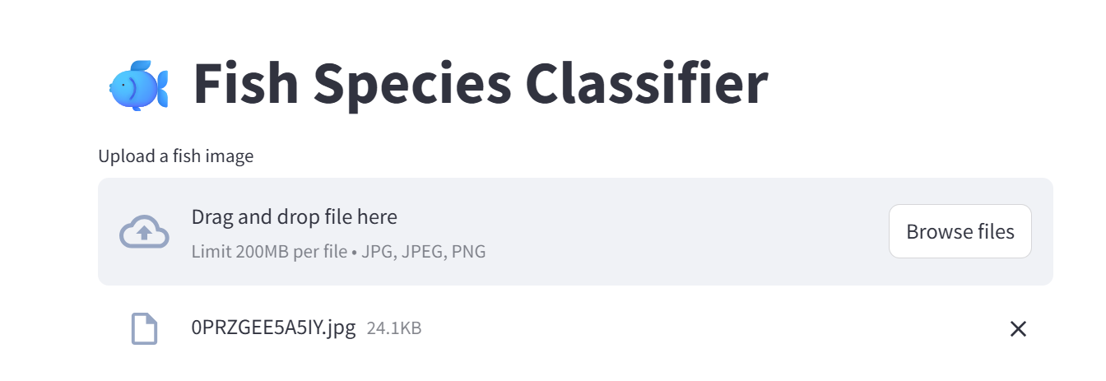
DEPLOYMENT
Used Streamlit for web app
Allows users to upload fish images and view predictions
Displays:
Predicted class
Confidence score
Top 3 predictions

Slide 11
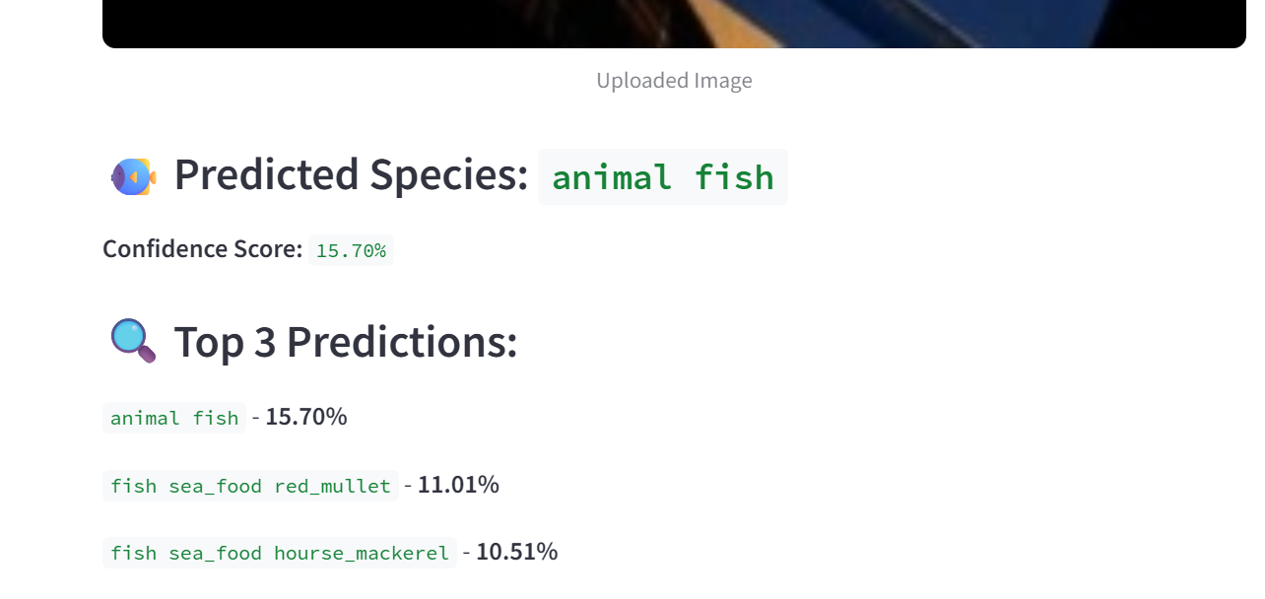
RESULTS & OUTPUT
Screenshots of app UI
Sample predictions
Confidence scores
Observations on model consistency

Slide 12
CONCLUSION
This project successfully demonstrates the use of deep learning for image-based fish species classification.
Multiple CNN architectures were experimented with, including EfficientNetB0, VGG16, and custom CNNs.
Among all, EfficientNetB0 achieved the best performance in terms of accuracy and generalization on unseen data.
Data augmentation and transfer learning significantly enhanced model robustness, especially on limited fish image datasets.
The final Streamlit application provides an interactive and user-friendly interface to classify fish species with confidence scores and top predictions.
The model can assist in automated sorting, biodiversity research, fishery monitoring, and marine resource management.

